Slide 1
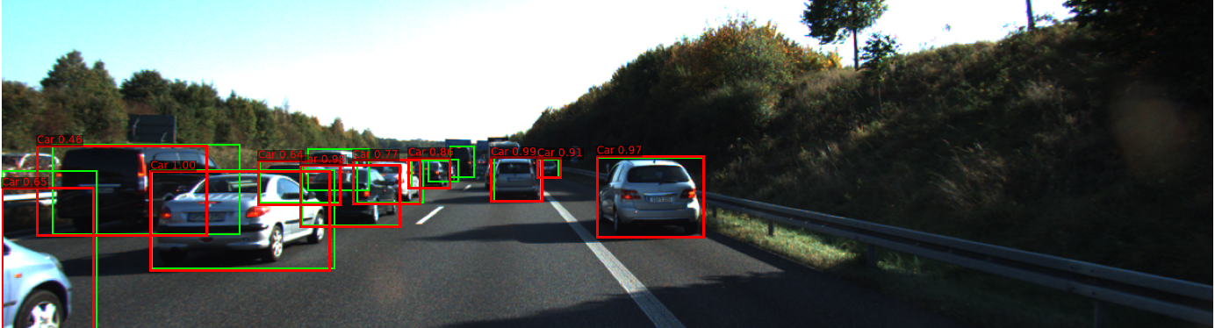
Camera–LiDAR Fusion for Object Detection on KITTI
3D PERCEPTION & LEARNING-BASED DATA FUSION · PROJECT 2
Camera-only vs LiDAR-only vs fusion, with classical machine learning
Presented by Sri Hari Padmanaban
Notes:
Good morning. This is Project 2 of the course. In Project 1 I worked with the KITTI LiDAR scans, the calibration files and the labels, and drew 3D bounding boxes around labelled objects. In this project I take the next step: I build detectors that predict objects from the raw camera images and LiDAR point clouds, and I measure how good they are against the KITTI labels. The main question is whether fusing the two sensors detects objects better than either sensor alone. The image behind me is a real validation frame: red boxes are the fusion detector's predictions, green boxes are the ground truth.

Slide 2
Contents
01 From Project 1 to Project 2
06 Results
02 Sensors and why fuse them
07 Where and why it fails
03 Data, splits and ground truth
08 Ground truth and limitations
04 The three detectors
09 Learnings and challenges
05 Evaluation protocol
10 Conclusion and Project 3
2
Notes:
Here is the structure of the talk. I start from where Project 1 ended, explain the two sensors and the data, then the three detectors I built. The most important part is the evaluation: how I measured the detectors, the results, and where and why each one fails. I finish with what the ground truth does and does not cover, what I learned, and how this leads into Project 3.

Slide 3

From Project 1 to Project 2
PROJECT 1
PROJECT 2
Geometry and visualisation
Prediction and measurement
Read KITTI scans, labels and calibration, transform LiDAR into camera coordinates and draw oriented 3D boxes.
Predict objects from raw camera and LiDAR data, without seeing labels, then score the predictions against the labels.
Does fusing camera and LiDAR detect obstacles better than either sensor alone?
3
Notes:
Project 1 gave me the geometric foundation: reading the KITTI files, transforming LiDAR points into the camera frame with the calibration matrices, and building oriented 3D boxes from the labels. Project 2 builds on that. Now the system must find the objects on its own, from the raw sensor data, and the labels are only used afterwards to measure how right or wrong it is. The research question is simple: does fusing the camera and the LiDAR detect obstacles better than either sensor on its own? To answer it I built three detectors and scored all three in exactly the same way.

Slide 4
Two sensors with complementary strengths
Camera
LiDAR
Strong: dense pixels, colour and texture; good at what an object looks like.
Strong: measures 3D position and distance directly; independent of lighting.
Weak: no direct depth; distant objects are only a few pixels tall.
Weak: sparse, especially far away; no colour or texture.
Fusion idea: LiDAR finds where an object is, the camera helps decide what it is. Classes: Car, Van, Truck, Pedestrian, Cyclist.
4
Notes:
Why fuse at all? The two sensors fail in different ways. The camera gives a dense, high-resolution picture with colour and texture, which is what you need to recognise what something is, but it has no direct depth and a car at 50 metres is only a few pixels tall. The LiDAR measures the 3D position of every point directly and does not care about lighting, but its points are sparse, especially far away, and it has no colour or texture. So the idea of fusion is to let LiDAR find where an object is, and use the camera to help decide what it is. I detect five KITTI classes: car, van, truck, pedestrian and cyclist.

Slide 5
KITTI data, splits and ground truth
7,481 labelled training frames: image, 64-beam LiDAR scan, calibration, labels. Split into disjoint groups:
Ground truth is partial
Only objects in the left camera’s view are labelled
Distant or tiny objects are often unlabelled or marked DontCare
Boxes contain annotator noise
3,000
train camera models
2,900
So a detection with no matching label may be a real but unlabelled object: precision is measured against the labels.
train LiDAR and fusion
600
evaluation only
5
Notes:
KITTI’s public test set has no labels, so I split the 7,481 labelled training frames into three groups that never overlap: 3,000 frames train the camera models, 2,900 frames train the LiDAR and fusion classifiers, and 600 frames are used only for evaluation. This matters: if a model is scored on frames it trained on, the score is inflated. It is also important to be clear about the ground truth. It is human annotation, and it is partial: only objects visible in the left camera are labelled, very distant or tiny objects are often unlabelled or marked DontCare, and the boxes have some annotator noise. So when a detection matches no label, it might be a real object that nobody labelled. That means every precision number I show is precision against the labels, not against reality.

Slide 6

Three detectors, one yardstick
Camera-only
Image
HOG features
SVM sliding window
2D boxes
LiDAR-only
Point cloud
RANSAC + DBSCAN
Random forest on cluster features
2D boxes
Fusion
LiDAR clusters
+ camera evidence
Random forest on both
2D boxes
All three are classical machine learning (no neural networks), run on a CPU, and are scored on the same 600 frames with the same metric.
6
Notes:
Here is the whole system on one slide. The camera-only detector looks only at the image: it computes HOG features and slides an SVM classifier over the image. The LiDAR-only detector looks only at the point cloud: it removes the road with RANSAC, groups the remaining points into clusters with DBSCAN, and a random forest classifies each cluster. The fusion detector reuses the LiDAR clusters, adds camera evidence for each cluster, and a random forest decides using both. All three output 2D boxes with a class and a score, so I can score all three on the same 600 frames with the same metric. Everything is classical machine learning running on a CPU; no neural networks in this project.

Slide 7
Camera-only: HOG and a sliding SVM
1
2
3
4
5
HOG features
One SVM per class
Sliding window
Hard negatives
Refine and NMS
Describe a patch by the direction of its edges
Every position, over 8 image scales for near and far objects
3 rounds of retraining on background it wrongly accepted
Regress each box, then remove duplicates
Object vs everything else, with a window shape per class
Why it stays weak
One template must cover every viewpoint of a class, objects are often only 25–40 px tall, there is no depth, and car, van and truck look alike in grey-scale edges.
7
Notes:
The camera-only detector is the classic Dalal and Triggs approach. HOG, histogram of oriented gradients, describes an image patch by the directions of its edges. I train one linear SVM per class, each with a window shape that matches the class, for example wide for cars and tall for pedestrians. To find objects, the window slides over every position in the image, and the image is resized to eight scales so that both near and far objects fit the window. Because almost all windows are background, I retrain three times on background windows the SVM wrongly accepted; that is hard-negative mining. Finally a regression model adjusts each box, and non-maximum suppression removes duplicates. The method has clear limits: one template per class has to cover a car seen from behind and from the side, objects are often tiny, there is no depth, and car, van and truck look very similar in grey-scale edges.

Slide 8
LiDAR-only: clusters and a random forest
1
2
3
4
5
Select points
RANSAC
DBSCAN
~30 features
Classify, refine
Keep points inside the image, 1–60 m ahead
Fit the road plane and remove it
Group nearby points (0.7 m) into candidate objects
Size, height profile, density, distance, reflectance
Random forest: 5 classes + background; learned 2D box correction
48.1% → 60.8%
LiDAR mAP before and after learned box refinement: boxes projected from visible points were often too small, so box quality mattered more than the classifier.
8
Notes:
The LiDAR-only detector works on the point cloud. First I keep only points that fall inside the camera image and are between 1 and 60 metres ahead, the region where labels exist. Most points hit the road, so RANSAC fits a plane to the road and removes it; otherwise every object would merge into one blob. DBSCAN then groups points that are within 0.7 metres of each other into clusters, and each cluster is a candidate object. Each cluster is described by about 30 hand-designed numbers: its length, width and height, its height profile, density, distance and LiDAR reflectance. A random forest, 300 decision trees voting, classifies each cluster into one of the five classes or background. To compare with the 2D labels, each cluster is projected into the image. Those projected boxes were often too small, because they only cover the visible points, so I trained a second model to correct them. That single step raised LiDAR mean average precision from 48.1 to 60.8 percent.

Slide 9

Fusion: LiDAR, feature-level
LiDAR geometry
The ~30 features of each cluster
Fusion random forest
One classifier sees both sensors and outputs a class and a score for each cluster
Camera evidence on the cluster’s box
SVM class scores + an image-crop classifier trained on cluster boxes, clutter included
What the fusion relies on (feature importance)
LiDAR geometry 74%
Camera 26%
Camera scores for training frames are produced out-of-fold, so the forest never learns from unrealistically good scores.
9
Notes:
The fusion detector uses the same LiDAR clusters as candidates; LiDAR decides where to look. For each cluster I then add camera evidence computed on its box in the image: the scores of the camera SVMs, and the scores of a second camera classifier trained directly on cluster boxes, including all the background clusters like bushes, poles and walls. One random forest receives the LiDAR geometry and the camera evidence together and decides the class. This is called feature-level fusion. The feature importance shows what the forest actually relies on: about three quarters LiDAR geometry and one quarter camera. One technical detail: for the training frames, the camera scores are produced out-of-fold, by models that never saw those frames, so the forest does not learn to trust scores that are unrealistically good.

Slide 10
Results: LiDAR dominates, fusion adds a little
Camera-only mAP
LiDAR-only mAP
Fusion mAP
2.2%
60.8%
62.0%
AP (%) | Car | Van | Truck | Pedestrian | Cyclist | mAP
Camera-only | 8.9 | 0.8 | 0.4 | 0.4 | 0.7 | 2.2
LiDAR-only | 87.1 | 56.2 | 42.0 | 45.9 | 72.9 | 60.8
Fusion | 88.1 | 59.2 | 42.6 | 46.5 | 73.5 | 62.0
11
Notes:
Here are the main results on the 600 validation frames. The camera-only detector reaches a mean average precision of only 2.2 percent. LiDAR-only reaches 60.8 percent, and fusion 62.0 percent. So LiDAR is by far the stronger single sensor in this classical setting, and fusion improves on it slightly. Per class, cars are detected very well by LiDAR and fusion, around 87 to 88 AP. Cyclists are also good. Vans, trucks and pedestrians are harder, between 42 and 59. Fusion is equal to or above LiDAR-only in every class, and the largest gain is on vans, plus 3 points.

Slide 11
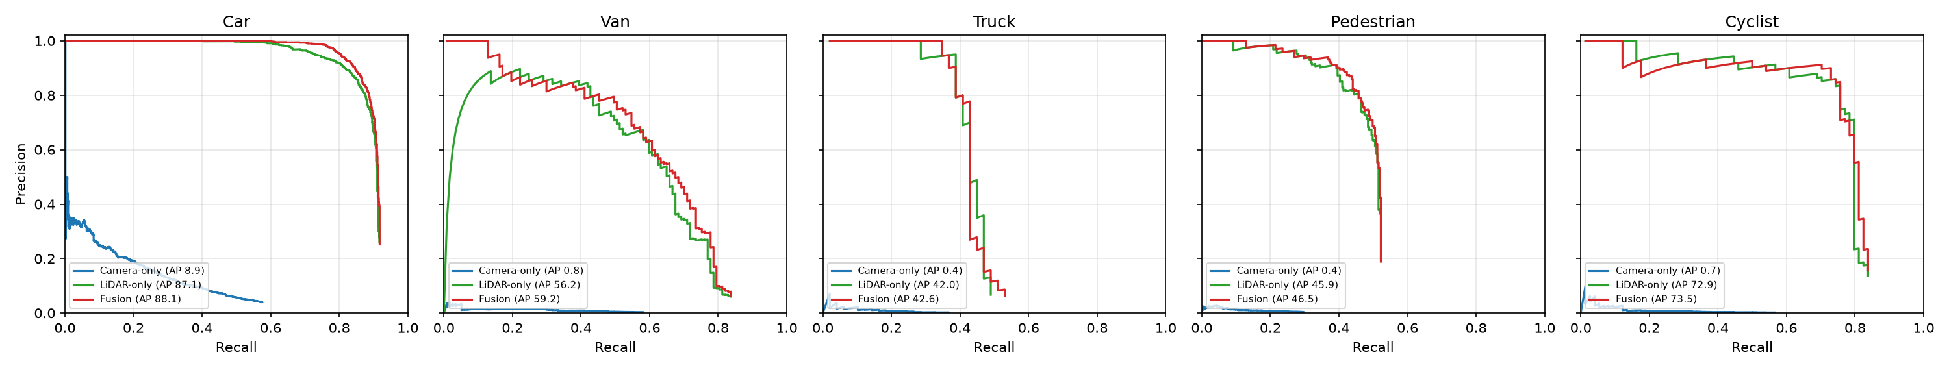
Precision–recall curves per class
Camera stays near zero
Fusion sits above LiDAR
Curves stop early
Low precision at every recall, in every class
Most visible for Car and Van: higher precision at the same recall
Truck and Pedestrian end near 50% recall: objects never proposed
12
Notes:
The precision-recall curves show the same story in more detail. Blue is camera-only, green is LiDAR-only and red is fusion. The camera curve stays close to zero precision in every class. Fusion runs on top of or slightly above LiDAR, most visibly for cars and vans: at the same recall it keeps a higher precision, which means fewer false alarms. The third thing to notice is where the curves stop. For trucks and pedestrians the curves end at around 50 percent recall: no matter how low the threshold, half of those objects are never found. The next slide explains why.

Slide 12
Where it fails, and why?
Class | True objects | Cluster recall IoU ≥ 0.5 | Cluster recall IoU ≥ 0.3 | Camera max recall
Car | 1278 | 92.3% | 95.9% | 57.6%
Van | 117 | 87.2% | 94.0% | 58.1%
Truck | 49 | 59.2% | 63.3% | 36.7%
Pedestrian | 293 | 54.6% | 78.2% | 29.7%
Cyclist | 74 | 85.1% | 89.2% | 56.8%
Pedestrians: loose boxes
Found 78% at IoU 0.3, only 55% at 0.5: thin objects
Trucks: missing clusters
Only 63% even at 0.3: out of view or occluded
Camera: method limit
At most 58% of cars found, at any threshold
Cluster recall: share of true objects with any LiDAR candidate box, the ceiling for LiDAR-only and fusion.
13
Notes:
This is the diagnostic table, and it is the key to understanding the failures. Cluster recall is the share of true objects for which LiDAR produced at least one candidate box. It is a hard ceiling: if LiDAR never proposes an object, no classifier and no camera feature can recover it. For cars and vans this ceiling is high, around 90 percent. Two classes stand out, highlighted in red. Pedestrians: a cluster exists for 78 percent of them if we accept an overlap of 0.3, but only 55 percent at 0.5, so the objects are found but the boxes are loose; on a thin object, a small shift costs a lot of IoU. Trucks: even at 0.3 only 63 percent are proposed, so the clusters are genuinely missing, typically because the truck is partly outside the field of view, occluded, or merged with something else. The camera detector has a different limit: even at the lowest threshold it finds at most 58 percent of cars, which is a limit of the single-template HOG method.

Slide 13
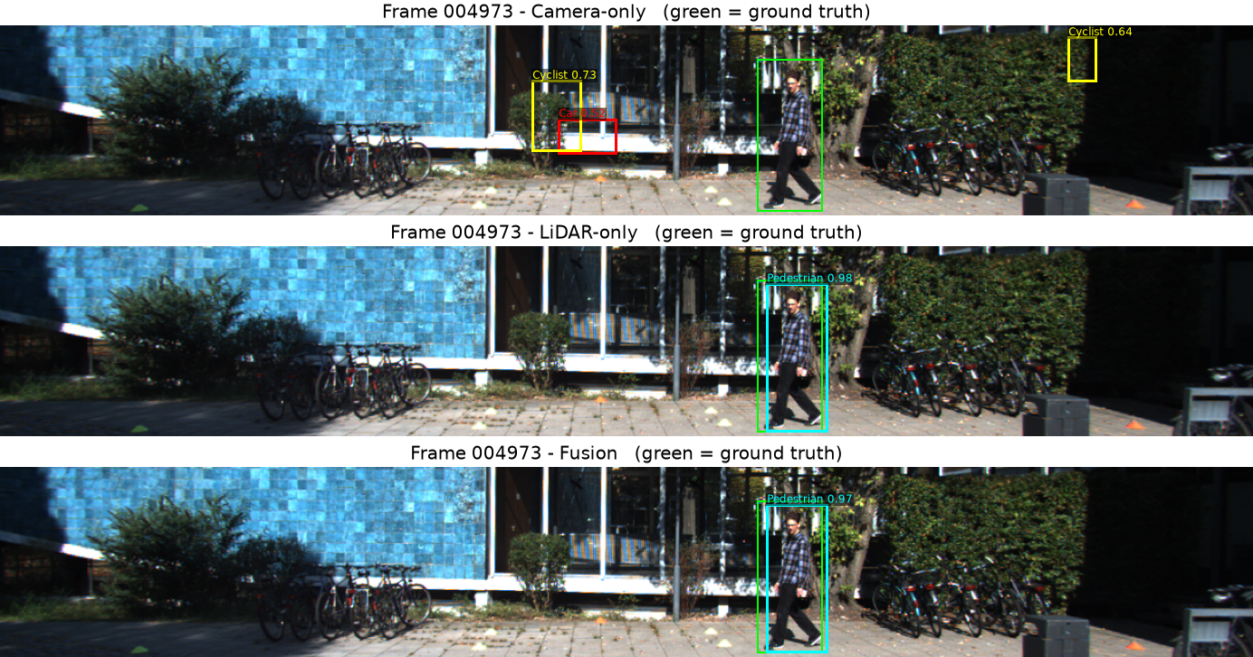
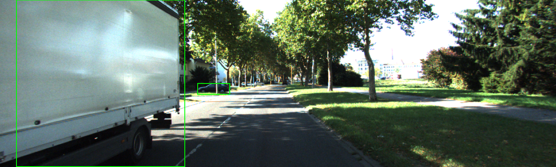
Validation Frames
FUSION HELPS · FRAME 004973
SHARED FAILURE · FRAME 002886
The truck at the image edge is missed by all three detectors: it is cut off by the field of view, so LiDAR never forms a usable cluster.
Camera fires on bushes and the entrance and misses the pedestrian; LiDAR and fusion find it (green = ground truth).
14
Notes:
Two real validation frames make the numbers concrete. On the left, frame 004973: the camera-only detector, at the top, fires on bushes and the building entrance and misses the pedestrian. LiDAR-only and fusion both find the pedestrian, because the person is a clear compact 3D cluster. Notice the detected box is slightly offset from the green annotation: that is the loose-pedestrian-box effect from the previous slide. On the right, frame 002886: a large truck at the left edge of the image is missed by all three detectors. The truck is cut off by the field of view, so LiDAR never forms a usable cluster for it, and fusion cannot recover it either. This is exactly the missing-cluster failure for trucks.

Slide 14
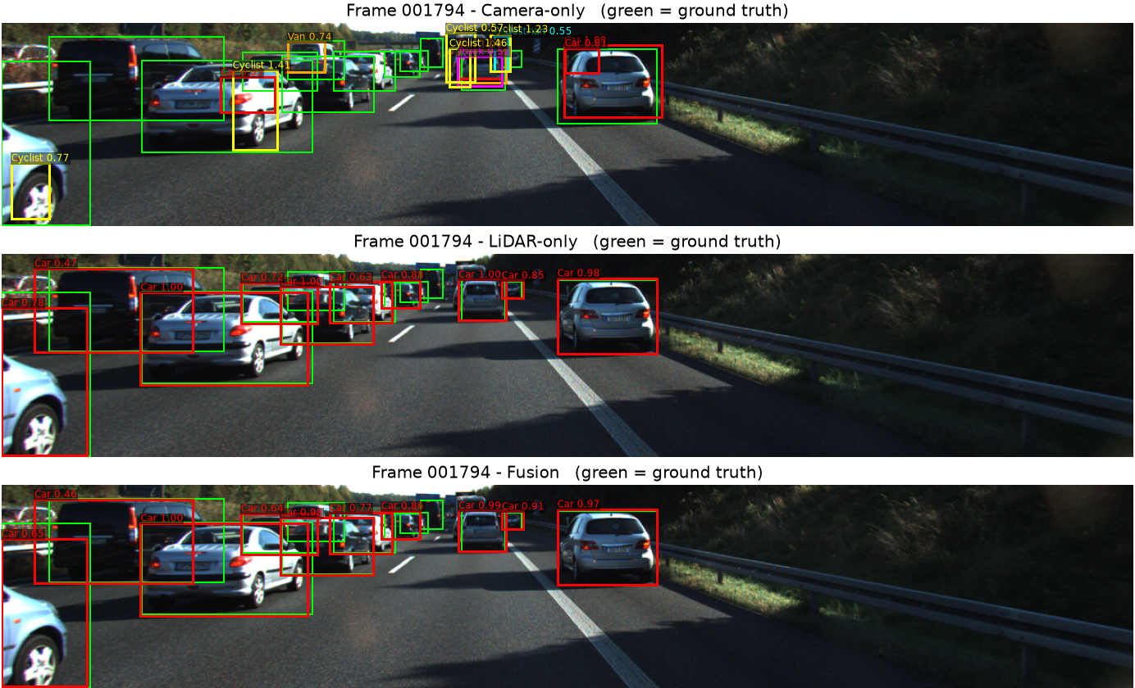
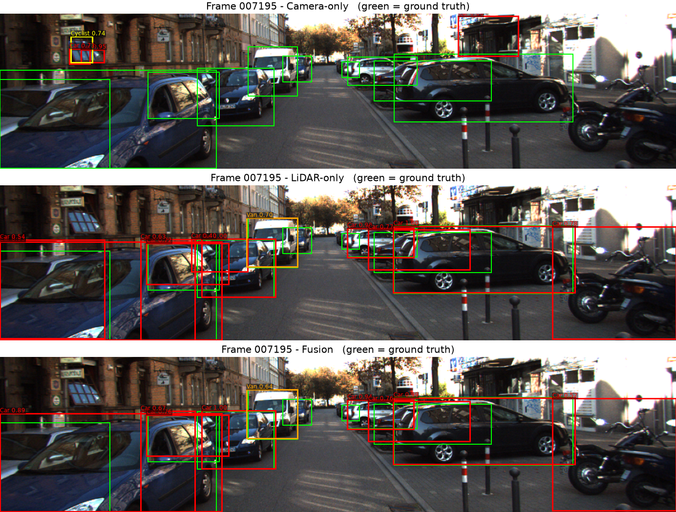
Validation Frames
HIGHWAY · FRAME 001794
CITY STREET · FRAME 007195
Camera mislabels cars as cyclists; LiDAR and fusion find nearly every car in dense traffic.
Camera fires on windows; LiDAR and fusion find the parked cars and the van.
15
Notes:
Two more validation frames, each shown for camera-only at the top, LiDAR-only in the middle and fusion at the bottom; green is always the ground truth. On the left, frame 001794 on a highway in dense traffic. The camera-only detector misses most of the cars and even labels some of them as cyclists, because a car seen from behind at a small size does not match its single car template. LiDAR-only and fusion put a box on nearly every labelled car, because each car is a clear compact 3D cluster. On the right, frame 007195 on a city street. The camera fires on building windows, while LiDAR and fusion find the row of parked cars and correctly classify the white van as a van. Two details worth pointing out: fusion raises the score of the partly visible car at the left edge, from 0.54 to 0.89, and lowers the score of the box on the parked motorcycles at the right edge, from 0.78 to 0.52. The motorcycles have no label in this frame, so that box counts as a false positive against the labels, which is exactly the ground-truth effect I described earlier.

Slide 15
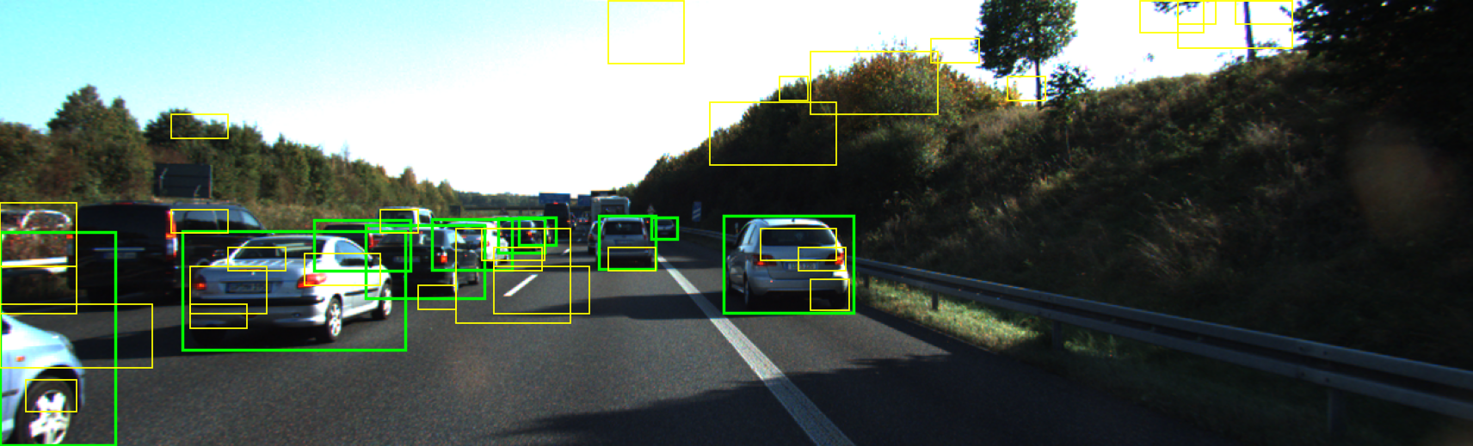
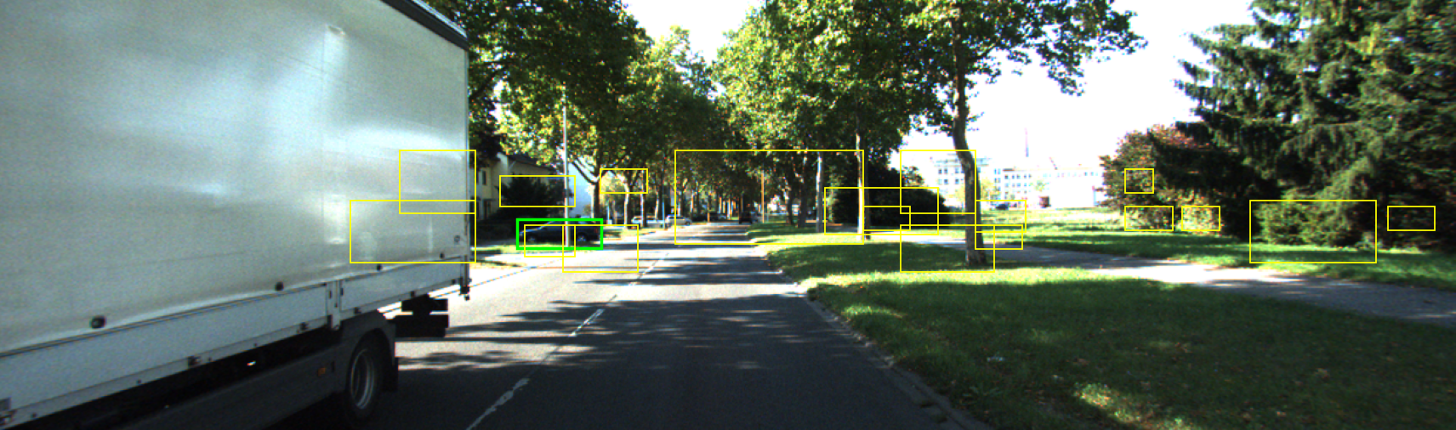
False alarms in an early version
HOG-SVM CANDIDATES · FRAME 001794
EARLY FUSED OUTPUT · FRAME 002886
Yellow boxes in the sky, trees and hillside: edge texture that a single HOG template accepts as a car.
Boxes on trees, bushes and grass: LiDAR clusters of vegetation that looked object-sized.
How the final system reduces them
Three rounds of hard-negative mining on background windows, LiDAR clusters as the only candidates, and a camera classifier trained on cluster boxes that include clutter such as bushes, poles and walls.
16
Notes:
False alarms were the main problem during development, and these two screenshots come from an early version of the pipeline. Yellow boxes are detections, green boxes are the labels. On the left, the raw HOG-SVM candidates on the highway frame: many boxes sit in the sky, on the trees and on the hillside. The texture of leaves and branches produces strong edges, and a single HOG template accepts some of them as a car. On the right, an early fused output on frame 002886: many boxes on trees, bushes and grass, because vegetation can form LiDAR clusters of roughly object size. These failures shaped the final design. Hard-negative mining retrains the SVMs three times on exactly this kind of background. Only LiDAR clusters are allowed as candidates, which removes the boxes in the sky. And the camera classifier used in fusion is trained on cluster boxes including clutter like bushes, poles and walls, so it learns to reject them. That is where the precision gain of fusion comes from.

Slide 16
What fusion adds and how far to trust it
0.89 → 0.92
+3.0 AP
26%
Car precision at the best-F1 point, recall unchanged at 0.83
Vans: the camera helps tell a van from a car
Share of the fusion forest’s decisions based on camera evidence
How far to trust the differences
Only 117 vans, 74 cyclists and 49 trucks are in the validation set, so differences of about one AP point on these classes are within noise. The car and van gains are more credible compared to other classes.
17
Notes:
So what does fusion actually add? The gain comes through precision, not recall. For cars, precision at the best operating point rises from 0.89 to 0.92 while recall stays at 0.83: the camera rejects clutter like bushes and walls that look like objects to LiDAR. For vans, AP rises by 3 points, because the camera helps tell a van from a car. And about a quarter of the fusion forest’s decisions rely on camera evidence. But I also want to be honest about how far to trust these numbers. The validation set has only 117 vans, 74 cyclists and 49 trucks, so a difference of one AP point on those classes is within noise. The car and van gains are more credible, but I did not run a significance test; a bootstrap over the validation frames would be the next step.

Slide 17
Ground truth: what it covers, and if it is missing
In this project: partial labels
Without any labels
Precision is measured against the labels, not reality
Evaluation covers only the camera’s field of view
DontCare regions are excluded from scoring
Rare classes give noisy numbers
AP, precision and recall cannot be computed
Hand-label a small subset and report metrics on it with their uncertainty
Proxy checks: camera–LiDAR agreement, temporal consistency, plausible sizes
Report proxies and visual checks as such, not as accuracy
18
Notes:
Ground truth deserves its own slide, because every number in this talk depends on it. In this project the labels exist, but they are partial. That has concrete consequences: precision is measured against the labels and not against reality, so some of my false positives may be real but unlabelled objects; the evaluation only covers the camera’s field of view; DontCare regions are excluded; and rare classes give noisy numbers. What if there were no labels at all, for example on our own recordings? Then AP, precision and recall simply cannot be computed. The evaluation would still be possible, but partial: I would hand-label a small subset, even 50 frames, and report metrics on it with their uncertainty. On top of that I would use proxy checks, such as whether camera and LiDAR agree, whether detections are consistent from one frame to the next, and whether object sizes are physically plausible. Those must be reported as proxies, not as accuracy.

Slide 18
Learnings and challenges
Learnings
Challenges
Got to know about HOG and SVM based detector
Training and evaluation data must stay apart
Camera evidence helps only when trained on the boxes it will see
Limited number of frames with vans, trucks and cyclists.
Flooded with false alarms in the beginning and overcame by several rounds of hard negative mining
The camera detector added almost nothing to fusion, then improved slightly by training crop classifiers on the cluster boxes
19
Notes:
A few lessons from the project. First, calibration is what makes fusion possible at all, by putting both sensors in one coordinate frame. Second, measuring first and then improving paid off: the diagnostics showed that box quality, not the classifier, was the bottleneck, and fixing it gave the biggest jump. Third, training and evaluation data must stay strictly apart, including the camera scores fed to the fusion forest. And camera evidence only helped once it was trained on the same kind of boxes it sees at test time. The challenges were the weak camera baseline, the small number of trucks, vans and cyclists, and compute time on a CPU. The limitations: I used the same validation frames to guide development, I evaluate in 2D at IoU 0.5 rather than the official protocol, the 3D accuracy is not evaluated yet, and the method assumes a flat road, daylight and single frames.

Slide 19
Conclusion and next step
LiDAR dominates in this classical setting: mAP 60.8% against 2.2% for the camera.
PROJECT 3
Fusion adds precision, reaching 62.0% mAP with fewer false alarms.
Learning-based fusion with neural networks
One network learns from camera and LiDAR jointly, replacing hand-designed features.
Remaining errors are explained: missing truck clusters, loose pedestrian boxes, single-template HOG.
Predicts full 3D bounding boxes (position, size, orientation), evaluated against the 3D labels. This project is the baseline.
References: [1] Geiger et al., KITTI benchmark, CVPR 2012 · [2] Dalal & Triggs, HOG, CVPR 2005 · [3] Ester et al., DBSCAN, KDD 1996 · [4] Fischler & Bolles, RANSAC, Comm. ACM 1981 · [5] Breiman, Random forests, Machine Learning 2001 · [6] Lang et al., PointPillars, CVPR 2019
20
Notes:
To conclude. In this classical setting LiDAR is clearly the dominant sensor, with a mean average precision of 60.8 percent against 2.2 for the camera. Fusion adds a small but consistent gain, 62.0 percent, mainly by removing false alarms. And thanks to the diagnostics, the remaining errors are explained: trucks are missed because their clusters are missing, pedestrians because their boxes are loose, and the camera because of the single-template HOG method. These results are the baseline for Project 3, where I will move to learning-based fusion with neural networks, so that one network learns from camera and LiDAR jointly instead of relying on features I designed by hand. Project 3 will also predict full 3D bounding boxes, with position, size and orientation, and evaluate them against the 3D labels. Deep detectors like PointPillars give the reference level to compare against. Thank you; I am happy to take questions.

Slide 20
THANK YOU!
21
Notes:
To conclude. In this classical setting LiDAR is clearly the dominant sensor, with a mean average precision of 60.8 percent against 2.2 for the camera. Fusion adds a small but consistent gain, 62.0 percent, mainly by removing false alarms. And thanks to the diagnostics, the remaining errors are explained: trucks are missed because their clusters are missing, pedestrians because their boxes are loose, and the camera because of the single-template HOG method. These results are the baseline for Project 3, where I will move to learning-based fusion with neural networks, so that one network learns from camera and LiDAR jointly instead of relying on features I designed by hand. Project 3 will also predict full 3D bounding boxes, with position, size and orientation, and evaluate them against the 3D labels. Deep detectors like PointPillars give the reference level to compare against. Thank you; I am happy to take questions.

